Slide 1
^{Chapter 5} Tree
ZAMAN UNIVERSITY
Data Structures and Algorithms

Slide 2
Outline
Binary Trees
Traversing Binary Tree
Red-Black Trees
Red-Black Tree Insertions
2-3-4 Trees

Slide 3
Outline
Binary Trees
Traversing Binary Tree
Red-Black Trees
Red-Black Tree Insertions
2-3-4 Trees

Slide 4
Binary Trees
Binary Trees are one of the fundamental data structures used in programming
Binary Trees provide advantages that the data structures such as arrays and lists cannot

Slide 5
Why Use Binary Trees?
Usually because it combines the advantages of two other structures: an ordered array and a linked list
Slow insertion and deletion in an ordered array:
during insertion a new item into an ordered array, you first must find where the item will go, and then move all the items with greater keys up one space
deletion involves the same multimove operation
Slow Searching in a Linked List:
searching will be start checking from head until find the looking item
Trees is data structure with the quick insertion and deletion

Slide 6
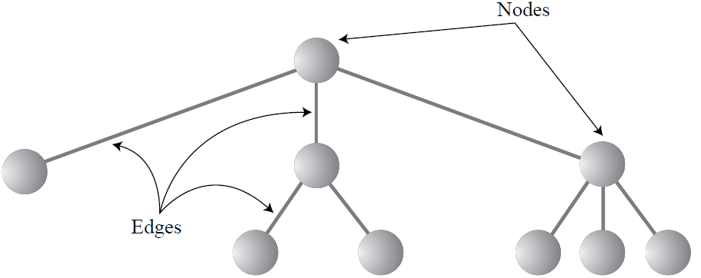
What Is a Tree?
A tree consists of nodes connected by edges
The nodes are represented as circles, and the edges as lines connecting the circles
Typically there is one node in the top row of a tree, with lines connecting to more nodes on the second row, even more on the third, and so on
Thus trees are small on the top and large on the bottom
There are different kinds of trees: binary tree and multiway tree

Slide 7
Tree Terminology¹
Path - Think of someone walking from node to node along the edges that connect them. The resulting sequence of nodes is called a path.
Root - The node at the top of the tree is called the root. There is only one root in a tree.
Parent - Any node (except the root) has exactly one edge running upward to another node. The node above it is called the parent of the node.
Child - Any node can have one or more lines running downward to other nodes. These nodes below a given node are called its children.
Leaf - A node that has no children is called a leaf node or simply a leaf. There can be only one root in a tree, but there can be many leaves.

Slide 8
Tree Terminology²
Subtree - Any node can be considered to be the root of a subtree, which consists of its children, and its children’s children, and so on. If you think in terms of families, a node’s subtree contains all its descendants.
Visiting - A node is visited when program control arrives at the node, usually for the purpose of carrying out some operation on the node, such as checking the value of one of its data members, or displaying it.
Traversing - To traverse a tree means to visit all the nodes in some specified order.
Levels - The level of a particular node refers to how many generations the node is from the root. If we assume the root is Level 0, its children will be Level 1, its grandchildren will be Level 2, and so on.

Slide 9
Tree Terminology³
Keys - In tree diagrams, when a circle represents a node holding a data item, the key value of the item is typically shown in the circle.
Binary Trees - If every node in a tree can have at most two children, the tree is called a binary tree. The two children of each node in a binary tree are called the left child and the right child.
Binary Search Tree is - a node’s left child must have a key less than its parent, and a node’s right child must have a key greater than or equal to its parent.

Slide 10
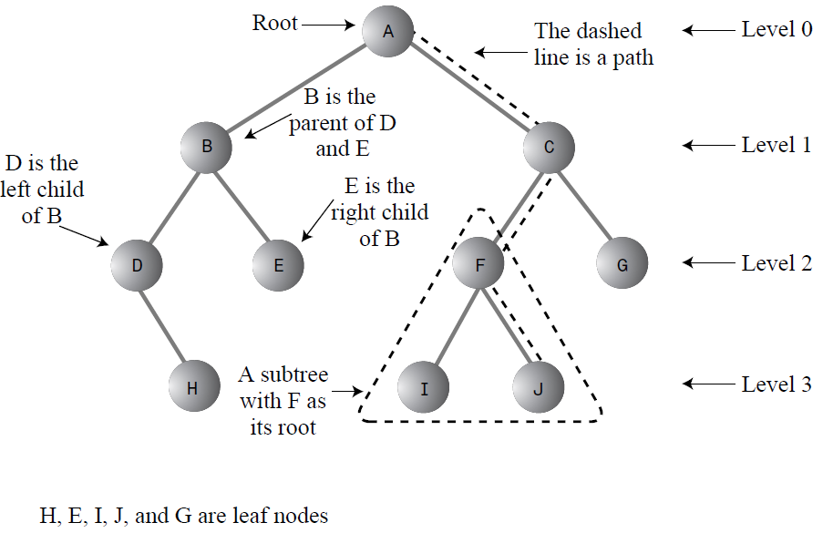
Tree Terms

Slide 11
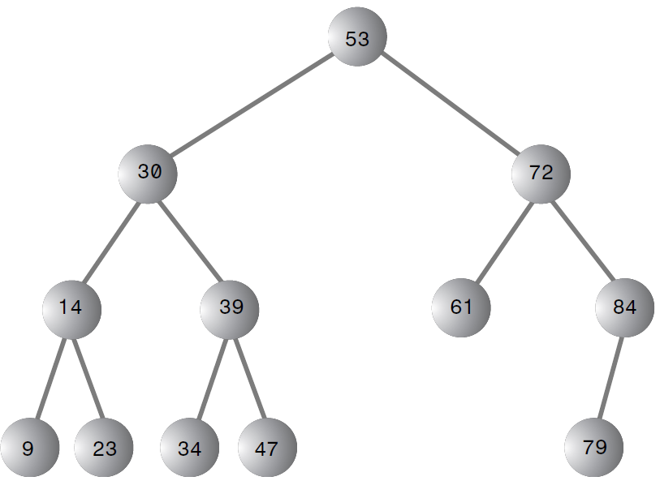
A Binary Search Tree

Slide 12
Search in BST
Start at the root
Compare the value of the item you are searching for the value stored at the root
If the values are equal, then item found; otherwise, if it is a leaf node, then not found
If it is less than the value stored at the root, then search the left subtree
If it is greater than the value stored at the root, then search the right subtree
Repeat steps 2-6 for the root of the subtree chosen in the previous step 4 or 5

Slide 13
Insert New Node in BST
Insert(Node root, Key k)
1. if (root == null) // insertion position found
2. return new Node(k);
3. if (k <= root.key) // proceed to the left branch
4. root.left = Insert(root.left, k);
5. else // k > root.key, i.e. proceed to the right branch
6. root.right = Insert(root.right, k);
https://www.cs.usfca.edu/~galles/visualization/BST.html

Slide 14
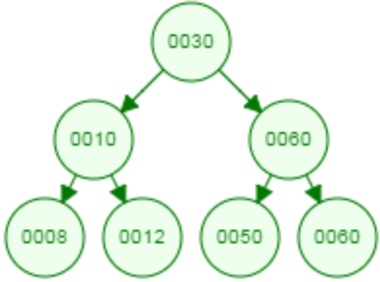
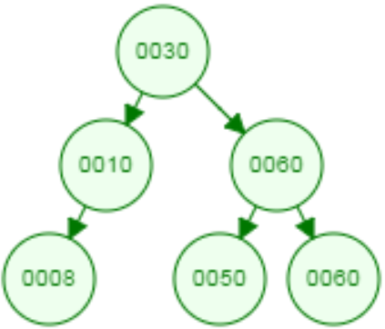
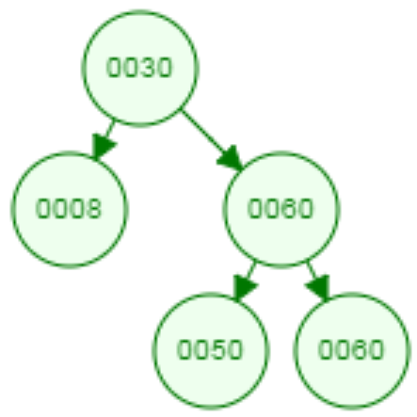
Delete Node in Binary Search Tree
During deletion node, there possibilities arise:
1. Deleted node is leaf
2. Deleted node has only one child
Delete 12
Delete 10

Slide 15
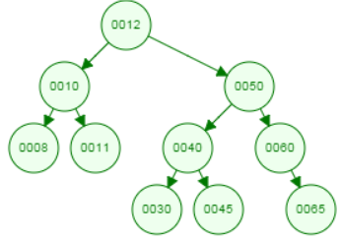
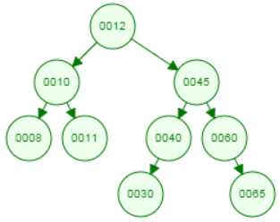
Delete Node in Binary Search Tree (cont.)
3. Deleted node has two children - replace node with largest value in left subtree
Delete 50

Slide 16
Pseudo Code of Deletion a Node from BST
1. Find a node with value likes Key
2. Study the found (deleted) node for the following condition:
2.1. node is leaf: Just remove it from BST;
2.2. node has one child: replace node with the child node
2.2.1. if the node has right child then replace with right child;
2.2.2. if the node has left child then replace with left child;
2.3. node has two children: replace node with largest value in left sub-tree
2.3.1. Go to Left child (LeftSubChild) of deleted node
2.3.2. if LeftSubChild has no children (left and right) then replace deleted node with LeftSubChild
2.3.3. if LeftSubChild has right child then
2.3.4. go to the end of right child (node with largest value)
2.3.5. replace node with largest value with deleted node
2.3.4. if LeftSubChild has NO right child
then replace LeftSubChild with deleted node

Slide 17

Create a class of Binary Search Tree
Create a search function in BST
Create an insertion function in BST
Create deletion function in BST

Slide 18
To be continued…

